Slide 1



MAINEHEALTH DIRECT-TO-EMPLOYER PLAN FINANCIAL MODELING
September 27, 2024

Slide 2



Founded in 1979 and headquartered in Indianapolis, IN​
Full-service TPA specializing in the administration of self-funded health plans and population health management​
One of the country’s largest independently-owned TPAs
The Key Family is a commonly-held group of benefits related organizations with:​
3,000+ corporate clients​
3.0 million members under management​
700 Employees
Exclusive Relationships
We know The Market – Agents, Networks, and MGAs

Slide 3


Market Leader in Private Labeled DTE Plans
Louisville, KY
OneHealth Plan
Cincinnati, OH
TCH Optimal
Bentonville, AR
Northwest Health Plan
Knoxville, TN
East Tennessee Health Plan
Meridian, MS
Affinity Health Plan
Fort Myers, FL
Lee Health Care Partners

Slide 4

Direct-to-Employer (DTE) Your Health Plan Focused on a Direct Relationship with Self-Funded Employers in Your Market
YOU Pick the Name of the Health Plan
YOU Determine the Fees Charged
YOU Practice the Medicine
YOU Receive the Profits
WE Make it Successful

Slide 5


Margin and Revenue Impacting Variables in Plan Design
1
2
Pricing
To overcome the brand recognition that carriers have built, this plan will need to be priced ~15% below current BUCAH Pricing
Net Revenue
KBA’s unique DTE approach enables health systems to offer employers lower rates while still netting the health system with comparable-to-commercial net revenues:
KBA has friendly payment policies that promote higher plan collections with less churn.
KBA provides patient cards to members allowing for no-interest loans on the patient-responsibility portion of bills, dramatically improving self-pay collection
Patient Steerage
(MaineHealth Only Plan)
If this plan remains an exclusive MaineHealth DTE, KBA expects improved patient steerage towards MaineHealth providers and care.

Slide 6
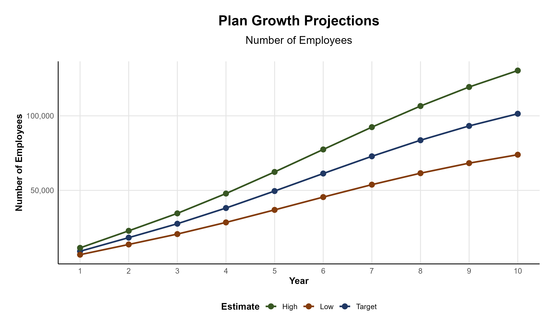
Estimated Plan Growth Potential
Total Employees at Companies with 50+ Employees
(Excluding Health System Employees)
13,550
PLAN GROWTH POTENTIAL
4,275
14,325
42,475
8,548
5,200
16,525
31,500
6,625
15,150
27,425
9,175
13,500
13,000
124,750
36,500
Number of Employees
25,000
100,000

Slide 7
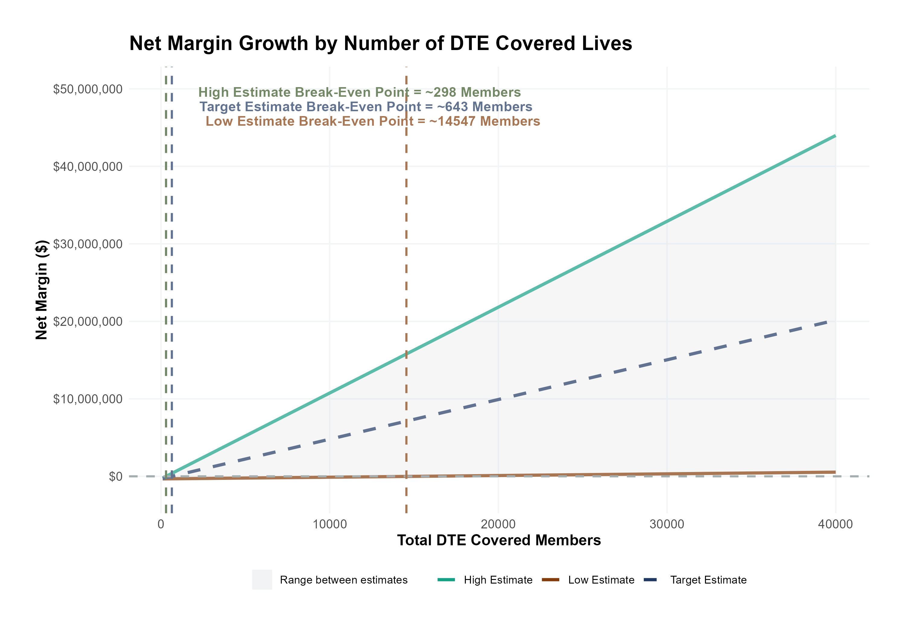
Modeling Assumptions for Steerage and Net Margin
Patient Steerage Assumptions
KBA currently estimates that MaineHealth has 77% inpatient market share, and 33% outpatient market compared to hospitals/clinics in Western Maine. We expect the percentage of new plan members who are currently not choosing MaineHealth to be steered to MaineHealth as follows:
SINGLE-YEAR PROJECTION
Low
Target
High
40%
60%
80%
DTE Margin Assumptions
KBA observes that MaineHealth has a 15% commercial margin. We expect a similar margin for DTE members through easier billing and improved patient responsibility payments.
Low
Target
High
10%
15%
20%

Slide 8
Potential for Steerage Growth of Inpatient Discharges
Year | Employees | Members | Growth in Discharges
1 | 9,100 | 20,020 | 380
2 | 18,300 | 40,260 | 765
3 | 27,600 | 60,720 | 1,154
4 | 38,200 | 84,040 | 1,597
5 | 49,600 | 109,120 | 2,073
6 | 61,300 | 134,860 | 2,562
7 | 72,900 | 160,380 | 3,047
8 | 83,600 | 183,920 | 3,494
9 | 93,200 | 205,040 | 3,896
10 | 101,400 | 223,080 | 4,239
53,736
Current Discharges (2022)
Current number of discharges for every 1,000 commercial healthcare members (based on KBA data warehouse)
Expected number of discharges for every 1,000 DTE members (with target patient steerage)
108
127

Slide 9
Pre-DTE Cohort of 5,000 Members | Inpatient | Outpatient | Professional | Total
Revenue† | $ 10,359,758 | $ 7,831,387 | $ 3,657,191 | $ 21,848,335
Net Income‡ | $ 1,553,964 | $ 1,174,708 | $ 548,578.6 | $ 3,277,250
† Assuming proportional revenues from market shares of 77% (inpatient) and 33% (outpatient)
‡ Assuming a commercial margin of 15%
With DTE | Inpatient | Outpatient | Professional | Total
Revenue⁰ | $ 12,508,088 | $ 17,731,170 | $ 8,280,306 | $ 38,519,563
Net Income* | $ 1,876,213 | $ 2,659,676 | $ 1,242,046 | $ 5,777,935
⁰ Assuming 90.8% within-DTE market share for inpatient care and 70.8% for ambulatory/outpatient (60% of non-MaineHealth members now choosing MaineHealth)
* Assuming a DTE margin of 15%
Total Increase in Net Income | $ 2,500,684
Network Access Fee (Revenue) of $1 PMPM | $ 60,000
Total Profit Growth | $ 2,560,684
Minus Implementation Fee (One-Time) | -$ 150,000
Minus Sales and Marketing (Annual – Ongoing) | -$ 180,000
Total | $ 2,230,684

Slide 10
SINGLE YEAR SUMMARY
DTE Covered Members Financial Analysis | DTE Covered Members Financial Analysis | DTE Covered Members Financial Analysis | DTE Covered Members Financial Analysis | DTE Covered Members Financial Analysis | DTE Covered Members Financial Analysis | DTE Covered Members Financial Analysis | DTE Covered Members Financial Analysis
Target Estimate With Margins Similar to Current Commercial Margins and 60% Steerage of Current Non-MaineHealth Patients Towards MaineHealth | Target Estimate With Margins Similar to Current Commercial Margins and 60% Steerage of Current Non-MaineHealth Patients Towards MaineHealth. | Target Estimate With Margins Similar to Current Commercial Margins and 60% Steerage of Current Non-MaineHealth Patients Towards MaineHealth. | Target Estimate With Margins Similar to Current Commercial Margins and 60% Steerage of Current Non-MaineHealth Patients Towards MaineHealth. | Target Estimate With Margins Similar to Current Commercial Margins and 60% Steerage of Current Non-MaineHealth Patients Towards MaineHealth. | Target Estimate With Margins Similar to Current Commercial Margins and 60% Steerage of Current Non-MaineHealth Patients Towards MaineHealth. | Target Estimate With Margins Similar to Current Commercial Margins and 60% Steerage of Current Non-MaineHealth Patients Towards MaineHealth. | Target Estimate With Margins Similar to Current Commercial Margins and 60% Steerage of Current Non-MaineHealth Patients Towards MaineHealth.
DTE Members | Pre-DTE Revenue | Pre-DTE Margin | DTE Revenue | DTE Incr. Revenue | DTE Total Margin | DTE Incr. Margin | Net Margin Less DTE Fees
100 | $ 437K | $ 66K | $ 770K | $ 333K | $ 116K | $ 50K | $ -279K
500 | $ 2,185K | $ 328K | $ 3,852K | $ 1,667K | $ 578K | $ 250K | $ -74K
1,000 | $ 4,370K | $ 655K | $ 7,704K | $ 3,334K | $ 1,156K | $ 500K | $ 182K
2,500 | $10,924K | $ 1,639K | $ 19,260K | $ 8,336K | $ 2,889K | $ 1,250K | $ 950K
10,000 | $43,697K | $ 6,555K | $ 77,039K | $33,342K | $11,556K | $ 5,001K | $4,791K
20,000 | $87,393K | $13,109K | $154,078K | $66,685K | $23,112K | $10,003K | $9,913K
NOTE: Please see detailed financial analysis and assumptions used starting on page 21.
Financial projections do not include 340B contribution margin, which could represent $136 PMPM by optimizing 340B through Rx plan design, MaineHealth’s approved site(s) with network integration, and development of MaineHealth’s proprietary PBM program.

Slide 11
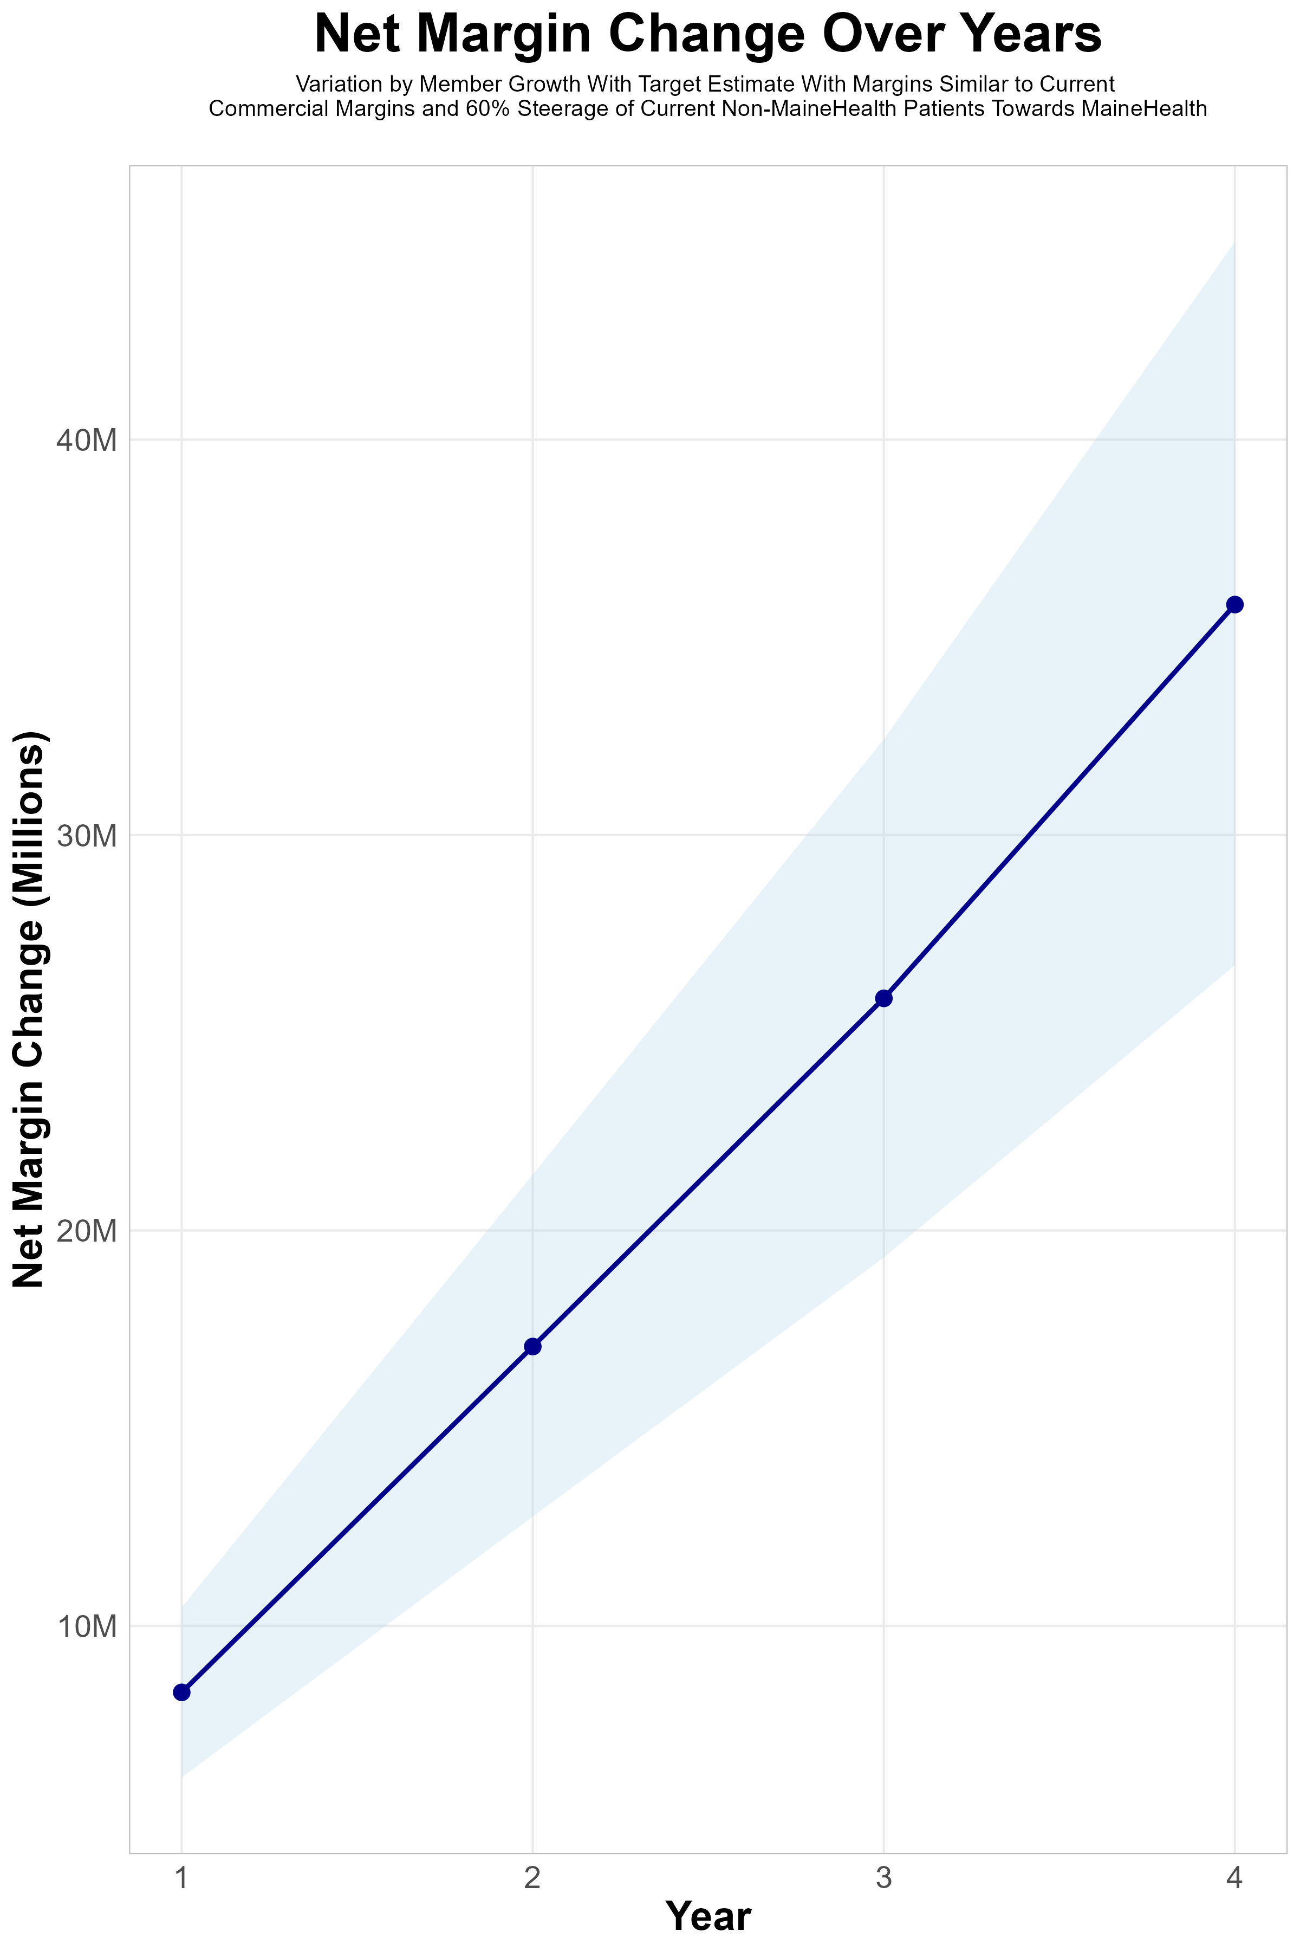
FOUR-YEAR PROJECTIONS
Target Member Growth | Target Member Growth | Target Member Growth | Target Member Growth | Target Member Growth
Metric | Year 1 | Year 2 | Year 3 | Year 4
Number of Members | 16,500 | 32,900 | 49,700 | 68,700
Incremental Margin | 8,450.3K | 16,849.3K | 25,453.2K | 35,183.8K
Network Access Fee | 198.0K | 394.8K | 596.4K | 824.4K
Implementation Fee (One-Time) | -150.0K | 0.0K | 0.0K | 0.0K
Sales and Marketing Costs | -180.0K | -180.0K | -180.0K | -180.0K
Net Margin Change | 8,318.3K | 17,064.1K | 25,869.6K | 35,828.2K
High Member Growth | High Member Growth | High Member Growth | High Member Growth | High Member Growth
Metric | Year 1 | Year 2 | Year 3 | Year 4
Number of Members | 20,600 | 41,200 | 62,200 | 86,200
Incremental Margin | 10,550.0K | 21,100.0K | 31,854.9K | 44,146.2K
Network Access Fee | 247.2K | 494.4K | 746.4K | 1,034.4K
Implementation Fee (One-Time) | -150.0K | 0.0K | 0.0K | 0.0K
Sales and Marketing Costs | -180.0K | -180.0K | -180.0K | -180.0K
Net Margin Change | 10,467.2K | 21,414.4K | 32,421.3K | 45,000.6K
Low Member Growth | Low Member Growth | Low Member Growth | Low Member Growth | Low Member Growth
Metric | Year 1 | Year 2 | Year 3 | Year 4
Number of Members | 12,400 | 24,700 | 37,200 | 51,300
Incremental Margin | 6,350.5K | 12,649.8K | 19,051.5K | 26,272.6K
Network Access Fee | 148.8K | 296.4K | 446.4K | 615.6K
Implementation Fee (One-Time) | -150.0K | 0.0K | 0.0K | 0.0K
Sales and Marketing Costs | -180.0K | -180.0K | -180.0K | -180.0K
Net Margin Change | 6,169.3K | 12,766.2K | 19,317.9K | 26,708.2K

Slide 12
MaineHealth NETWORK
Out of Network
Friends & Family (Contracted)
Wrap Network (Rented)
MaineHealth’s Network
The medical providers in your direct control or part of MaineHealth’s integrated delivery system
Potential risk sharing arrangements (e.g. employer stop-loss participation)
Friends & Family Providers – TIER 1
Access through direct contracts at the discretion of MaineHealth
WRAP NETWORK
Medical services from national PPO networks for members that travel, tertiary and specialty services you do not provide, and employees residing outside your direct catchment area
OUT-OF-NETWORK
Non-contracted medical providers

Slide 13

BENEFIT PLAN DESIGNS THAT OPTIMIZE STEERAGE TO MAINEHEALTH
Exclusive Provider Organization (EPO) Plan Design Structure

Slide 14

the missing piece to population health success
Patient engagement is the failure point of population health efforts. Direct employer participation and MaineHealth’s clinical leadership is key to driving patient engagement.
KBA’s DTE strategy positions MaineHealth to grow commercial market share by reducing per-employee plan costs even further at a time when employers are desperate for a path to better value.
MaineHealth can demonstrate greater completion rates for Standards of Care for the Chronically Ill, driving better care & cost outcomes.
Adding MaineHealth’s managed care processes to KBA’s patented care management programs will turbocharge results – Positioning MaineHealth as a transformational population health leader.
MaineHealth CAN PROMOTE THESE RESULTS FROM DAY ONE!!

Slide 15

CHRONIC CONDITION | MINIMUM ANNUAL CARE RECOMMENDED
ASTHMA | 2 Clinical Evaluations 1 Spirometry (for patients 10 years of age or older)
ATRIAL FIBRILLATION | 1 Clinical Evaluation
CHRONIC OBSTRUCTIVE PULMONARY DISEASE | 1 Clinical Evaluation 1 Spirometry
CHRONIC VENOUS THROMBOTIC DISEASE previously listed as Thrombo-embolic Disease | 1 Clinical Evaluation
COPD WITH PULMONARY HYPERTENSION/COR PULMONALE | 2 Clinical Evaluations 12 months of supplemental 02 Tx
CHRONIC KIDNEY DISEASE | 1 Clinical Evaluation 1 Hgb or Hcrt | 1 Serum Creatinine 1 Serum Potassium | 1 Serum Calcium 1 Serum Phosphorus
CONGESTIVE HEART FAILURE | 1 Clinical Evaluation | 1 Serum Creatinine | 1 Serum Potassium
CORONARY ARTERY DISEASE | 1 Clinical Evaluation | 1 LDL
DEPRESSION | 1 Clinical Evaluation
DIABETES | 2 Clinical Evaluations 2 Glycohemoglobins 1 Serum Creatinine | 1 Lipid Panel IF no nephropathy Dx or ACE/ARB Rx, 1 Urine Albumin/Creatinine ratio, Total Protein
EPILEPSY | 1 Clinical Evaluation
HUMAN IMMUNODEFICIENCY VIRUS INFECTION | 2 Clinical Evaluations 2CBCs I T-Cell/CD-4 Count | 2 HIV Quantifications 1 Pap Smear (for women only, 21 years of age or older)
Hyperlipidemia | 1 Lipid Panel
HYPERTENSION | 1 Clinical Evaluation | 1 Serum Creatinine
HYPERTHYROIDISM | 1 Clinical Evaluation | 1 TSH | 1 T4
HYPOTHYROIDISM | 1 Clinical Evaluation | 1 TSH
METABOLIC SYNDROME | 1 Clinical Evaluation | 1 Lipid Panel | 1 FBS or HgbA1c
MULTIPLE SCLEROSIS | 1 Clinical Evaluation
PARKINSON'S DISEASE | 1 Clinical Evaluation
PERIPHERAL ARTERIAL DISEASE (ATHEROSCLEROSIS] previously listed as Peripheral Vascular Disease | 1 Clinical Evaluation 1 LDL
PRE-DIABETES | 1 Clinical Evaluation | 1 Lipid Panel | 1 FBS or HgbA1c
POLYMYALGIA RHEUMATICA | 2 Clinical Evaluation | 2 ESR or CRP | 1 CBC
PULMONARY HYPERTENSION (UNRELATED TO COPD) | 2 Clinical Evaluation
REGIONAL ENTERITIS (INFLAMMATORY BOWEL DISEASE) | 1 Clinical Evaluation
RHEUMATOID ARTHRITIS | 1 Clinical Evaluation
SLEEP APNEA | 1 Clinical Evaluation
ULCERATIVE COLITIS (INFLAMMATORY BOWEL DISEASE) | 1 Clinical Evaluation
INTEGRATION WITH EPIC EHR SYSTEM
CHRONIC DISEASE MANAGEMENT
The chronic diseases identified include a list of services (i.e. exams, lab work and diagnostics) rendered by a network provider payable at 100% and not subject to the deductible or copay.
KBA shares evidence-based standards of care for 27 chronic conditions directly into Epic.

Slide 16

Transparent PBM Integration
Support of MaineHealth’s retail pharmacy(s)
Optimize MaineHealth’s 340B drug pricing program
Allows MaineHealth to create its own PBM program if desired
Custom telephone number with personalized scripting and separate call tracking & reporting
Fully customizable member welcome booklet & materials
White labeled formulary document and marketing materials
CUSTOM CLIENT SUPPORT:
Specialized call center capabilities
Fully customizable plan designs
Operational access to the platform
Customized process and functions to promote DTE strategy
CLINICAL FLEXIBILITY:
Full portfolio of custom formulary offerings – with optimized formulary shield
Clinical programs that drive towards overall DTE strategy
Options for additional drug savings by driving members to lower cost alternatives
Flexibility to customize or layer on utilization management programs

Slide 17
STOP-LOSS INSURANCE
Tokio Marine
Nationwide
Berkshire Hathaway
Sun Life
Liberty Mutual
Granular (Google)
Companion Life
Crum & Forster
American Fidelity
RGA
KBA has over 20 stop-loss underwriters and carriers that we work with on core employer sponsored plans and DTE health plans;
KBA performs a comprehensive analysis of each stop-loss partner to approve them for our business;
KBA provides comprehensive pricing and medical service analysis for each DTE health plan to ensure proper pricing;
KBA is also evaluated by the stop-loss markets to be an approved claims payer for them;
KBA provides the administration required of the stop-loss markets:
Bordereau Reporting;
Claim Reporting and Reconciliation;
Evaluation of Networks;
Care Management;
Initial Underwriting;
Negotiation of rates and terms; and
Plan Design Actuarial

Slide 18

DTE PROGRAM MARKETING & SALES
KBA WORKS WITH YOU TO MANAGE & SELL:
Branding & Messaging
Direct & Brokerage Sales Distribution – Focused Sales Representative
Brochures, Web Site, Media, etc.
Stop-Loss/Level Funded Down to 20 EE Lives
Sell Through Established Brokers in Your Service Area

Slide 19

Complete Sales Distribution System
BROKER DEVELOPMENT
Identification of Key Distribution Agents
Training and Development
DIRECT SALES
Identification of Key Targets
Working with MaineHealth on Specific Employers
SALES ADMINISTRATION
Quote System
Quote Evaluation
Compensation
Meet and Greet
Sales Process
Closing
Stop Loss Negotiations
Reporting & Analysis
Proposal Development

Slide 20









Complete Marketing System
Customized Branding and Messaging
Customized Brochures
Customized Web Site
Targeted Employer Outreach
Sales System (Social Media, Email, Text, etc.)

Slide 21

FINANCIAL PROJECTIONS & ASSUMPTIONS:

Slide 22
Estimation of MaineHealth’s 2022 Payer Mix
Payer Group | Total Inpatient Days | Revenue | Payer Mix
All MaineHealth | 241,613 | $2,910,468K | 100%
Medicare | 61,585 | $331,485K | 25%
Medicaid | 20,113 | $320,820K | 9%
Other Government Pay | 0
No-Pay, Charity Care | 10,923 | ($144,321K) | 4%
Commercial/Self Pay | 148,992 | $2,256,634K | 62%
Estimating Payer Mix
Medicare, Medicaid, and other government payer mixes are estimated as the percentage of inpatient days for each group divided by total inpatient days.
No-pay and charity care is estimated as the percentage of no-pay/charity care compared to total overall revenue.
Commercial/self pay is assumed to be the rest of the total payer mix share.
Estimating Total Inpatient Days
Total inpatient days for ‘No Pay’ and ‘Commercial’ are estimated to be the payer mix estimates for “No Pay, Charity Care” and “Commercial/Self Pay” multiplied by the total number of inpatient days.
Values in blue are taken from the 2021 Medicare Provider Cost Report (https://data.cms.gov/provider-compliance/cost-report/hospital-provider-cost-report/data)
Values in yellow are taken from Definitive Healthcare data.
In other analysis, the outpatient payer mix is assumed to mirror the inpatient payer mix.
Does not include Franklin Memorial Hospital as patient days reporting is not included in the Medicare Cost Report
Total Medicare patient revenue is reported by CMS in the Medicare Provider Analysis and Review Report (MedPAR)

Slide 23
Estimation of Margin for Commercial vs. Government Pay
Estimating Commercial Margin
(Calculated through counterfactual of assuming all CMS/Government pay was paying at commercial rates)
Estimating Gov-Pay Margin
(Calculated through counterfactual of assuming all commercial pay was paying at Medicare rate)
Estimated Total Revenue if All Patients Have Commercial Insurance* | $4,013,628K
Total Costs | $3,430,309K
Net Income | $583,319K
 | 15%
Estimated Total Revenue if All Patients Have Gov-Pay Insurance* | $1,623,520K
Total Costs | $3,430,309K
Net Income | $ -1,806,789K
 | -111%
Calculated by dividing the current commercial revenue by the current commercial inpatient day payer mix.
Calculated by dividing the current gov-pay revenue by the current gov-pay inpatient day payer mix.

Slide 24
Estimating Market Share
Hospital Name | Number of Beds | Inpatient Total Charges | Outpatient Total Charges | Inpatient Percent of Market Total | Outpatient Percent of Market Total (Assuming 56.1% of Physicians Employed by Hospitals)
Maine Medical Center | 679 | $2,535,572.0K | $2,033,029.6K | 60% | 18%
MaineHealth Maine Medical Center Biddeford | 140 | $ 302,313.7K | $ 656,817.3K | 7% | 6%
Mid Coast Hospital | 93 | $ 185,768.9K | $ 440,803.6K | 4% | 4%
Pen Bay Medical Center | 81 | $ 128,668.9K | $ 329,158.1K | 3% | 3%
Stephens Memorial Hospital | 25 | $ 41,272.3K | $ 170,079.7K | 1% | 1%
Franklin Memorial Hospital | 41 | $ 55,731.4K | $ 232,957.8K | 1% | 2%
Northern Light Mercy Hospital - Fore River Campus (FKA Mercy Hospital Fore River Campus) | 230 | $ 192,331.6K | $ 546,549.6K | 5% | 5%
York Hospital | 54 | $ 87,048.2K | $ 426,184.9K | 2% | 4%
Central Maine Medical Center | 187 | $ 440,788.3K | $ 729,686.3K | 10% | 6%
St Marys Health System (AKA St Marys Regional Medical Center) | 140 | $ 188,321.5K | $ 465,306.4K | 4% | 4%
Rumford Hospital | 25 | $ 20,246.4K | $ 95,017.3K | 0% | 1%
Bridgton Hospital | 25 | $ 20,800.2K | $ 100,957.0K | 0% | 1%
Northern Light Sebasticook Valley Hospital | 25 | $ 19,549.7K | $ 100,158.1K | 0% | 1%
Redington-Fairview General Hospital | 25 | $ 28,129.0K | $ 185,402.2K | 1% | 2%
For outpatient market share, it is estimated that only 56.1% of local physicians are employed by area hospitals (Research from the Physician Advocacy Institute: https://www.physiciansadvocacyinstitute.org/Portals/0/assets/docs/PAI-Research/PAI-Avalere%20Physician%20Employment%20Trends%20Study%202019-2023%20Final.pdf?ver=uGHF46u1GSeZgYXMKFyYvw%3d%3d)

Slide 25
Hospital Metrics | Hospital Metrics | Hospital Metrics | Hospital Metrics | Hospital Metrics | Hospital Metrics | Hospital Metrics | Hospital Metrics
Metric | Maine Medical Center | MaineHealth Maine Medical Center Biddeford | Mid Coast Hospital | Pen Bay Medical Center | Waldo County General Hospital | Stephens Memorial Hospital | Franklin Memorial Hospital
Total Hospital Days | 175,352 | 31,290 | 5,757 | 18,173 | 6,644 | 4,397 | Not in MCR
Total Medicare Days | 40,809 | 10,109 | 1,804 | 5,043 | 2,426 | 1,394 | Not in MCR
Total Medicaid Days | 13,969 | 1,987 | 952 | 1,409 | 929 | 867 | Not in MCR
Total Other Government Payer Days | 0 | 0 | 0 | 0 | 0 | 0 | 0
Total Inpatient Patient Revenue | $1,042,120K | $117,902.3K | $71,335.25K | $51,210.24K | $19,491.67K | $21,172.68K | $22,348.29K
Total Outpatient Patient Revenue | $835,575.1K | $256,158.8K | $169,268.6K | $131,004.9K | $107,977.5K | $87,250.88K | $93,416.06K
Total Medicare Revenue | $226,733K | $33,543.65K | $26,287.89K | $21,995.4K | $14,216.63K | $8,708.829K | $9,660.452K
Estimated Medicaid and Other Government-Pay Revenue | $48,951.43K | $187,340.9K | $15,113.14K | $20,137.92K | $19,489.23K | $29,787.63K | $9,773.263K
Estimated Commercial Revenue | $1,600,414K | $153,351.6K | $199,043.2K | $140,086.4K | $93,775K | $69,963.29K | $96,335.59K
Total Uncompensated Care | $66,442.32K | $15,326.68K | $16,892.81K | $31,626.33K | $9,054.128K | $4,979.534K | $11,673.28K
Estimated Inpatient Costs | $1,219,519K | $126,603.8K | $75,802.94K | $60,679.37K | $19,346.97K | $20,319.97K | $24,931.81K
Estimated Outpatient Costs | $977,814.2K | $275,064K | $179,869.8K | $155,228.6K | $107,175.9K | $83,736.92K | $104,215.2K
Total Operating Expenses | $2,197,333K | $401,667.8K | $255,672.7K | $215,908K | $126,522.9K | $104,056.9K | $129,147K
Net Income | $-321,234.5K | $-27,431.63K | $-15,228.47K | $-33,688.23K | $957.987K | $4,402.853K | $-13,377.7K
Estimated Inpatient Market Share | 59.7% | 7.1% | 4.4% | 3.0% | 0.0% | 1.0% | 1.3%
Estimated Outpatient Market Share | 17.5% | 5.7% | 3.8% | 2.8% | 0.0% | 1.5% | 2.0%
Estimated Commercial Profit Margin | 3.7% | 42.6% | 15.2% | 11.6% | 28.6% | 37.0% | 10.6%
1. Most data is taken from the CMS provider cost report | 1. Most data is taken from the CMS provider cost report | 1. Most data is taken from the CMS provider cost report | 1. Most data is taken from the CMS provider cost report | 1. Most data is taken from the CMS provider cost report | 1. Most data is taken from the CMS provider cost report | 1. Most data is taken from the CMS provider cost report | 1. Most data is taken from the CMS provider cost report
2. Medicare costs are taken from the Medicare Provider Analysis and Review (MedPAR) | 2. Medicare costs are taken from the Medicare Provider Analysis and Review (MedPAR) | 2. Medicare costs are taken from the Medicare Provider Analysis and Review (MedPAR) | 2. Medicare costs are taken from the Medicare Provider Analysis and Review (MedPAR) | 2. Medicare costs are taken from the Medicare Provider Analysis and Review (MedPAR) | 2. Medicare costs are taken from the Medicare Provider Analysis and Review (MedPAR) | 2. Medicare costs are taken from the Medicare Provider Analysis and Review (MedPAR) | 2. Medicare costs are taken from the Medicare Provider Analysis and Review (MedPAR)
3. Data with 'Estimated' in the title are derived from other data points. | 3. Data with 'Estimated' in the title are derived from other data points. | 3. Data with 'Estimated' in the title are derived from other data points. | 3. Data with 'Estimated' in the title are derived from other data points. | 3. Data with 'Estimated' in the title are derived from other data points. | 3. Data with 'Estimated' in the title are derived from other data points. | 3. Data with 'Estimated' in the title are derived from other data points. | 3. Data with 'Estimated' in the title are derived from other data points.
4. Market Share estimates based on total patient revenues with area hospitals. Ambulatory market share based on regional estimates of the percentage of local physicians employed by area hospitals. See Physician Advocacy Institute | 4. Market Share estimates based on total patient revenues with area hospitals. Ambulatory market share based on regional estimates of the percentage of local physicians employed by area hospitals. See Physician Advocacy Institute | 4. Market Share estimates based on total patient revenues with area hospitals. Ambulatory market share based on regional estimates of the percentage of local physicians employed by area hospitals. See Physician Advocacy Institute | 4. Market Share estimates based on total patient revenues with area hospitals. Ambulatory market share based on regional estimates of the percentage of local physicians employed by area hospitals. See Physician Advocacy Institute | 4. Market Share estimates based on total patient revenues with area hospitals. Ambulatory market share based on regional estimates of the percentage of local physicians employed by area hospitals. See Physician Advocacy Institute | 4. Market Share estimates based on total patient revenues with area hospitals. Ambulatory market share based on regional estimates of the percentage of local physicians employed by area hospitals. See Physician Advocacy Institute | 4. Market Share estimates based on total patient revenues with area hospitals. Ambulatory market share based on regional estimates of the percentage of local physicians employed by area hospitals. See Physician Advocacy Institute | 4. Market Share estimates based on total patient revenues with area hospitals. Ambulatory market share based on regional estimates of the percentage of local physicians employed by area hospitals. See Physician Advocacy Institute

Slide 26
Estimating PMPY Spend (KBA Data)
Category | Standardized Allowed Charges | Standardized Paid Charges | Member Years | Nationwide Average of Paid Claims | Adjusted to Androscoggin, Cumberland, Franklin, Knox, Lincoln, Oxford, Somerset, and York Counties Rates
Inpatient | $ 561,766,609 | $ 358,815,229 | 105,492 | $ 3,401 | $ 2755
OutPatient | $ 1,223,989,466 | $ 652,333,702 |  | $ 6,184 | $ 5008
Professional | $ 549,353,224 | $ 304,634,120 |  | $ 2,888 | $ 2339
KBA utilizes its data warehouse with greater than $3B in yearly adjudicated charges to estimate PMPY spend by inpatient, outpatient and professional charges. Pharmacy and non-health-system charges are excluded.
Using the Milliman area adjustment factors by zip code, charges are standardized to local estimates.
These estimated charges are conservative as KBA claims average ~15% below the market average.

Slide 27
Estimating Expected Steerage (KBA Data)
 | DTE Health Plan Tier 1 Utilization – Q1 2024
 | Charges | % | Paid | % | Discount Equivalent
 |  |  |  |  | Charge to Paid
Tier 1 |  | 81.26%
Current DTE Network #1 | $ 17,913,805.69 | 54.82% | $ 6,907,327.88 | 58.63% | -61.44%
Current DTE Network #2 | $ 8,460,570.40 | 78.37% | $ 3,280,571.45 | 77.62% | -61.23%
Current DTE Network #3 | $ 629,748.27 | 72.98% | $ 198,216.95 | 80.64% | -68.52%
Current DTE Network #4 | $ 58,261,069.02 | 96.15% | $ 12,968,046.77 | 93.20% | -77.74%
 | $ 85,265,193.38 |  | $ 23,354,163.05
DTE Steerage Impact on an EPO Plan Structure
KBA is modeling steerage in line with other observed DTE networks.

Slide 28
Target Estimate With Margins Similar to Current Commercial Margins and 60% Steerage of Current Non-MaineHealth Patients Towards MaineHealth | Target Estimate With Margins Similar to Current Commercial Margins and 60% Steerage of Current Non-MaineHealth Patients Towards MaineHealth | Target Estimate With Margins Similar to Current Commercial Margins and 60% Steerage of Current Non-MaineHealth Patients Towards MaineHealth | Target Estimate With Margins Similar to Current Commercial Margins and 60% Steerage of Current Non-MaineHealth Patients Towards MaineHealth | Target Estimate With Margins Similar to Current Commercial Margins and 60% Steerage of Current Non-MaineHealth Patients Towards MaineHealth
All values in thousands of dollars | All values in thousands of dollars | All values in thousands of dollars | All values in thousands of dollars | All values in thousands of dollars
Metric | 500 DTE Covered Lives | 1000 DTE Covered Lives | 5000 DTE Covered Lives | 25000 DTE Covered Lives
Pre-DTE Group Total Revenue | $2,276.6 | $4,553.3 | $22,766.4 | $113,832.2
Pre-DTE Group Total Margin | $205.3 | $410.7 | $2,053.3 | $10,266.4
DTE Group Total Revenue | $3,852.0 | $7,703.9 | $38,519.6 | $192,597.8
DTE Group Incremental Total Revenue | $1,575.3 | $3,150.6 | $15,753.1 | $78,765.6
Incremental Total Revenue by Member | $3.2 | $3.2 | $3.2 | $3.2
DTE Group Total Margin | $347.4 | $694.8 | $3,474.0 | $17,370.1
DTE Group Incremental Total Margin | $142.1 | $284.2 | $1,420.8 | $7,103.8
Wellness Share | $6.0 | $12.0 | $60.0 | $300.0
Implementation Fee (One-Time) | $150.0 | $150.0 | $150.0 | $150.0
Sales and Marketing Annual Fee | $180.0 | $180.0 | $180.0 | $180.0
Net Margin Less DTE Fees | $-181.9 | $-33.8 | $1,150.8 | $7,073.8

Slide 29
Target Estimate With Margins Similar to Current Commercial Margins and 60% Steerage of Current Non-MaineHealth Patients Towards MaineHealth | Target Estimate With Margins Similar to Current Commercial Margins and 60% Steerage of Current Non-MaineHealth Patients Towards MaineHealth | Target Estimate With Margins Similar to Current Commercial Margins and 60% Steerage of Current Non-MaineHealth Patients Towards MaineHealth | Target Estimate With Margins Similar to Current Commercial Margins and 60% Steerage of Current Non-MaineHealth Patients Towards MaineHealth | Target Estimate With Margins Similar to Current Commercial Margins and 60% Steerage of Current Non-MaineHealth Patients Towards MaineHealth
All values in thousands of dollars | All values in thousands of dollars | All values in thousands of dollars | All values in thousands of dollars | All values in thousands of dollars
Metric | 500 DTE Covered Lives | 1000 DTE Covered Lives | 5000 DTE Covered Lives | 25000 DTE Covered Lives
Pre-DTE Group Inpatient Revenue | $1,054.1 | $2,108.1 | $10,540.5 | $52,702.7
Pre-DTE Group Inpatient Margin | $95.1 | $190.1 | $950.6 | $4,753.2
DTE Group Inpatient Revenue | $1,250.8 | $2,501.6 | $12,508.1 | $62,540.4
DTE Group Inpatient Margin | $112.8 | $225.6 | $1,128.1 | $5,640.4
DTE Group Incremental Inpatient Revenue | $196.8 | $393.5 | $1,967.5 | $9,837.7
DTE Group Incremental Inpatient Margin | $17.7 | $35.5 | $177.4 | $887.2
Pre-DTE Group Outpatient Revenue | $833.4 | $1,666.8 | $8,334.0 | $41,669.9
Pre-DTE Group Outpatient Margin | $75.2 | $150.3 | $751.6 | $3,758.1
DTE Group Outpatient Revenue | $1,773.1 | $3,546.2 | $17,731.2 | $88,655.9
DTE Group Outpatient Margin | $159.9 | $319.8 | $1,599.1 | $7,995.7
DTE Group Incremental Outpatient Revenue | $939.7 | $1,879.4 | $9,397.2 | $46,985.9
DTE Group Incremental Outpatient Margin | $84.8 | $169.5 | $847.5 | $4,237.6
Pre-DTE Group Professional Revenue | $389.2 | $778.4 | $3,891.9 | $19,459.5
Pre-DTE Group Professional Margin | $35.1 | $70.2 | $351.0 | $1,755.0
DTE Group Professional Revenue | $828.0 | $1,656.1 | $8,280.3 | $41,401.5
DTE Group Professional Margin | $74.7 | $149.4 | $746.8 | $3,733.9
DTE Group Incremental Professional Revenue | $438.8 | $877.7 | $4,388.4 | $21,942.0
DTE Group Incremental Professional Margin | $39.6 | $79.2 | $395.8 | $1,978.9
Net Margin Less DTE Fees | $-181.9 | $-33.8 | $1,150.8 | $7,073.8

Slide 30





A Partner You Can Trust
OUR OBJECTIVES ARE ALIGNED
WE KNOW THE
MARKET
COMPLETELY TRANSPARENT
WE HAVE THE SOPHISTICATION AND INFRASTRUCTURE TO EFFECTIVELY COMPETE
Derek Moore, Senior Vice President – KBA
845-283-9973 * derek.moore@keybenefit.com

